Slide 1

Entity Framework
2 – Database First

Slide 2
What and Why Database First?
The database already exists
You want low level control of the database
DB is managed by DBA’s
Model changes are made in the database
Updated in the designer
Entire database can be generated from the model
Updates require a drop

Slide 3
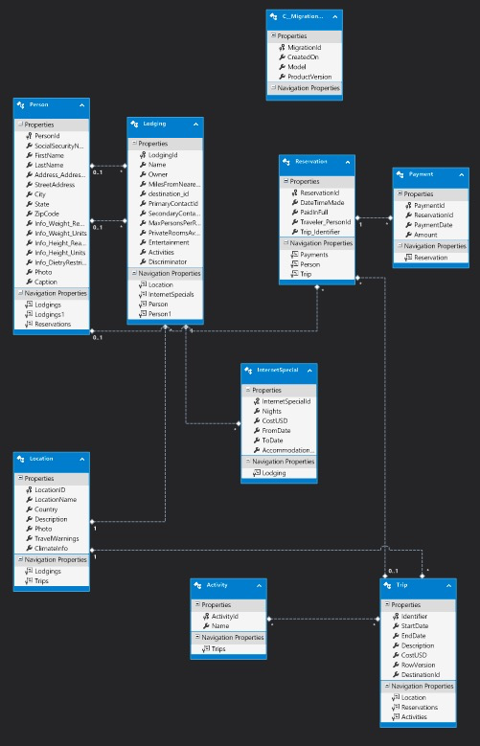
Demo: Import BreakAway
New class library project
Create data connection
Add ADO.NET Entity Model from the database
Explore the model

Slide 4
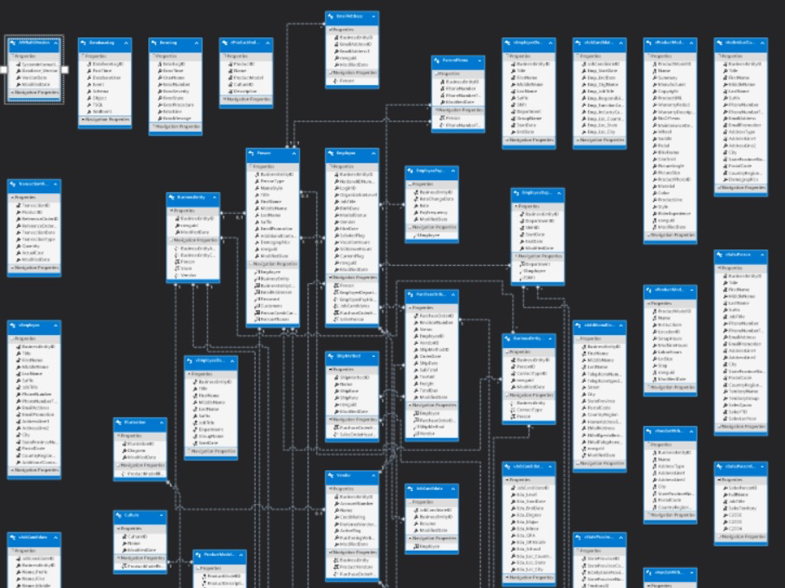
Demo: Import AdventureWorks

Slide 5
Explore the Model
Entities and Relationships
App.config
Generated code
Mappings are built from the code

Slide 6
Auto-generated COntent
*.edmx file
*.tt files
Model.context.tt
Model.tt
Context object in Model.Context.cs (generated)
Model.edmx.diagram
Model.edmx.diagram

Slide 7
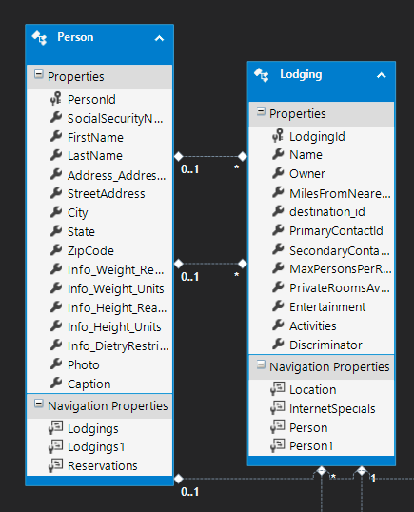
Entities Consist of:
Data Properties
Navigation Properties

Slide 8
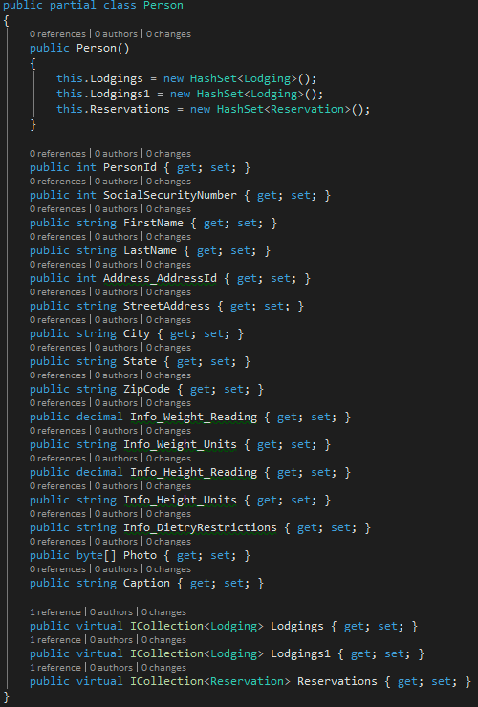
Entities
Example: Person
POCO
HashSets for relationships

Slide 9
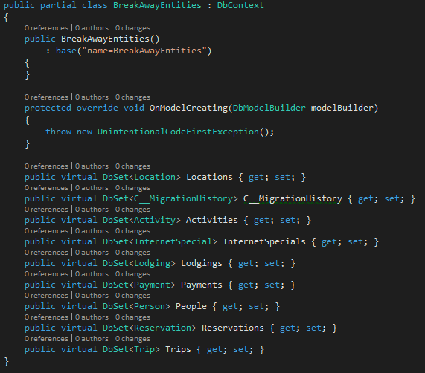
DbContext
The repository pattern for managing entities from the database
Each Table is a DbSet object

Slide 10
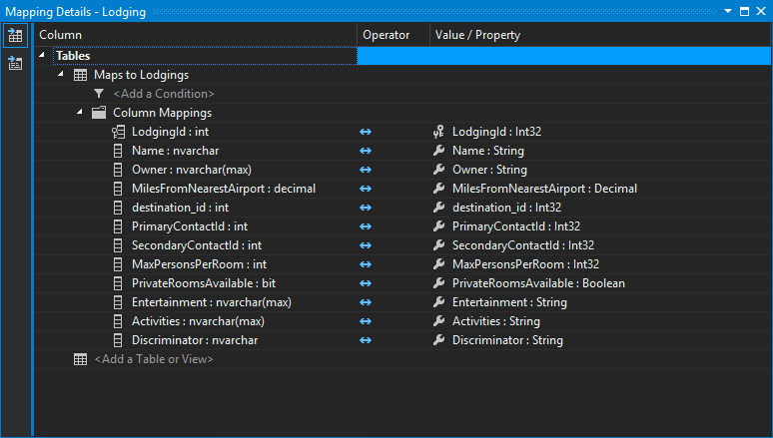
Table mappings

Slide 11
Update model from DB
Add a column to a table
Add new table
Update model from db option
Designer will not alter or remove existing properties
Validate model will show this
Change property type manually

Slide 12
Summary
Saw how to import a database model
Examined the generated content

Slide 13
Lab: Create model from database

